Slide 1

Hypothetical testing
using Python
Submitted by:
Manminder Kaur(0783604)
Submitted to:
Ms. Savita Seharawat

Slide 2

Hypothetical Testing
A formal statistical test called a hypothesis test is used to confirm or reject a statistical hypothesis using experimental data.
For example: boys are taller than girls

Slide 3
Normalization is the basis of a hypothesis.
Null hypothesis(H₀) and alternative hypothesis(Hₐ) are the two different methods of hypothesis testing.
The basis for a null hypothesis is an incidence (also referred to as the ground truth).
An alternative hypothesis is a presumption that contradicts the primary hypothesis.
In previous example:
Boys are taller than girls are assumed to be null hypothesis, H₀.
Boys are not taller than girls will be alternative hypothesis, Hₐ.

Slide 4
After considering null hypothesis and alternative hypothesis, there are two possible outcomes: -
The ground truth (H0) is true, so H0 is accepted.
The ground truth (H0) is not true, so H0 is rejected and H1 is accepted.
The rejection or accepting the null hypothesis is dependent based on p-value. P-values are used in hypothetical testing to help decide whether to reject the null hypothesis. The smaller the p-value, the more likely you are to reject the null hypothesis.

Slide 5
Different types of Hypothetical testing
T-test
Z-test
ANOVA test
Chi-Square test
Here, we’ll discuss t-test and z-test

Slide 6
T-test
T-test is used to determine whether the distribution of the data is according to normal distribution and calculating the similarity of the mean between one single set or two or more than two but for the population < 30. Thus, t-test have three different types: -
One-Sample t-test
Two-Sample t-test
Paired samples t-test

Slide 7
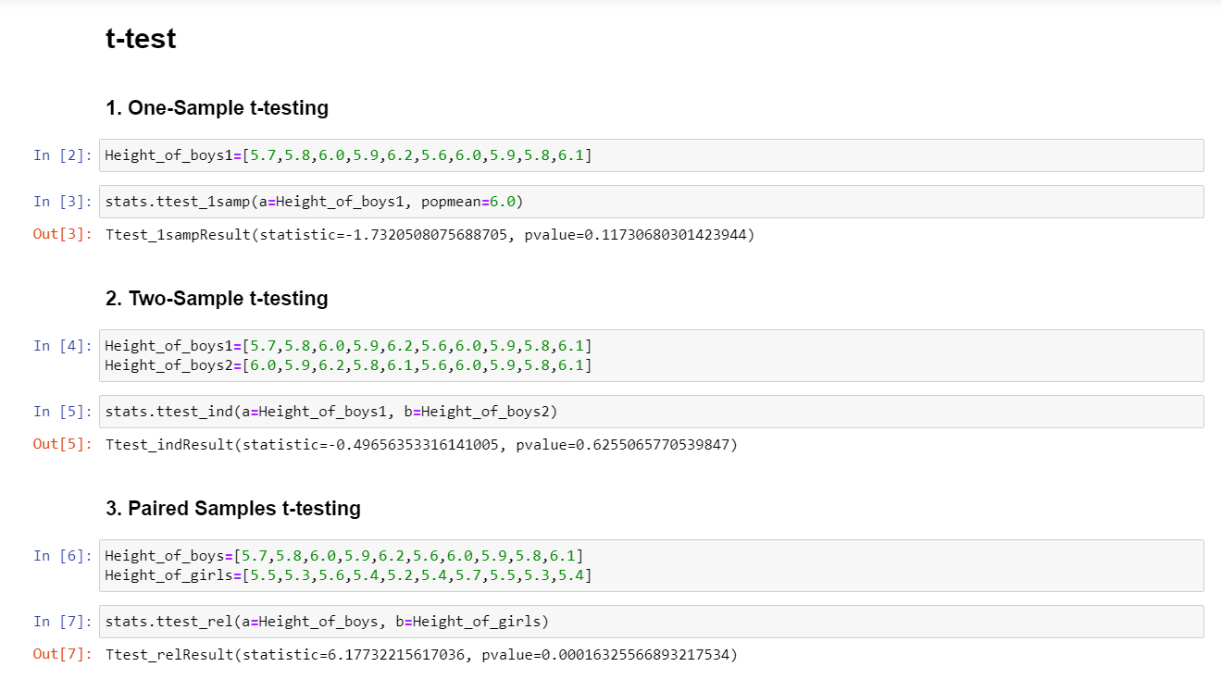

Slide 8
Z-test
Z-test is used to determine whether the distribution of the data is according to normal distribution and calculating the similarity of the mean between one single set or two or more than two but for the population >= 30. Thus, z-test have two different types: -
One-Sample z-test
Two-Sample z-test

Slide 9
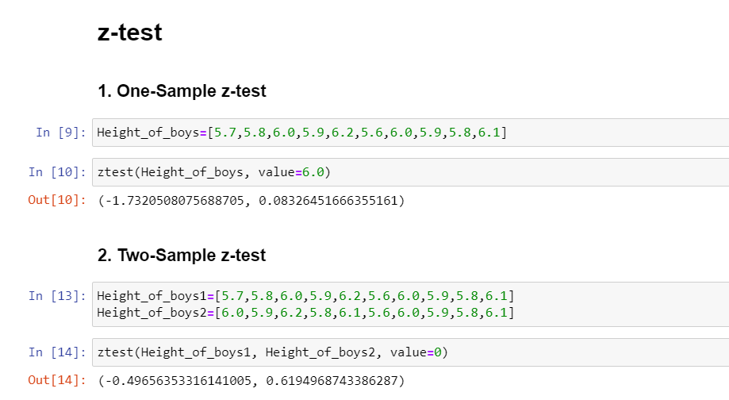

Slide 10
Let’s try these testing
on the Iris dataset

Slide 11
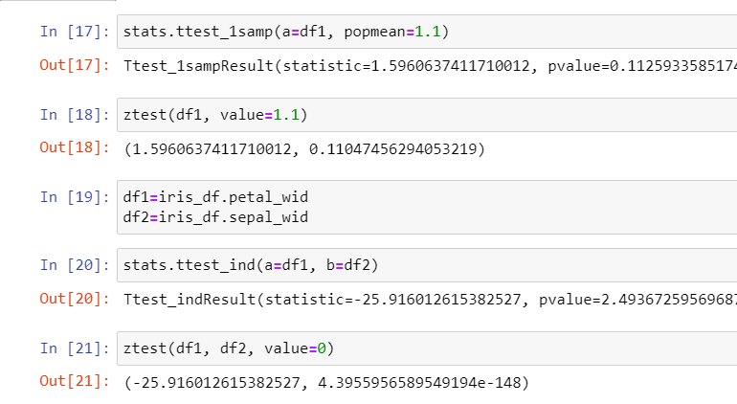

Slide 12
Thank You

